Slide 1
Trees
Non linear Data Structure

Slide 2
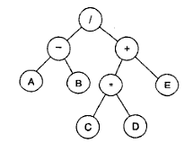
Here elements appear in non linear fashion.
Tree DS is used where an hierarchy relationship exist between data.
For algebraic expression, X=(a-b)/((c*d)+e).
Operations having highest precedence are at the lowest level.

Slide 3
Advantages of Tree DS
Represent and manipulate hierarchical data.
Easier to Search compared to linear DS.

Slide 4
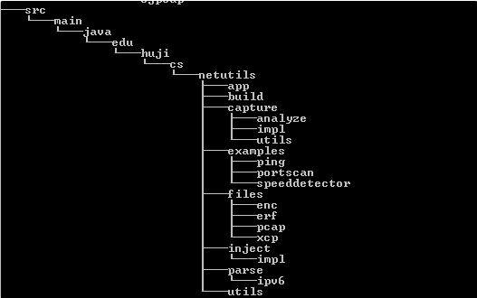
Application of trees
File System of computer.

Slide 5
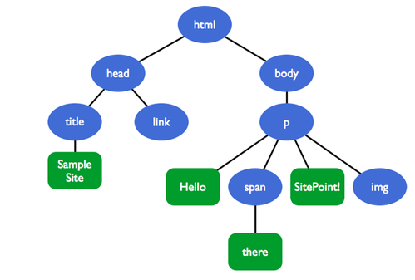
2. HTML Document Object Model (DOM):
All html text, attributes are stored in tree called Document Object Model (DOM).
3. Network Routing
4. Syntax checking of compilers.

Slide 6
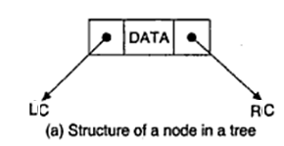
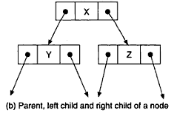
Basic Terminologies
1. Node- Fundamental unit of a tree. Stores data and pointers to other nodes.
2. Parent- immediate predecessor of a node
3. Child- Immediate successor(s) of a node

Slide 7
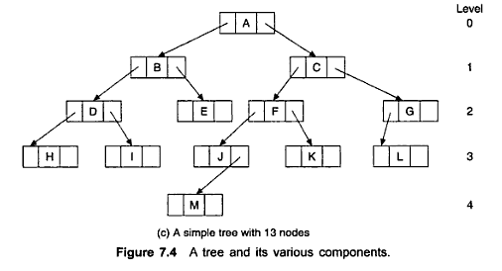
4. Link(or branch/edge)- Pointer to other nodes.
5. Root- A specially designated node which has no parent.
6. Leaf- Node at end which does not have any child nodes.
7. Level- Rank in the hierarchy
Always root node is at level 0
For all other nodes at level L, parent is at level L-1, child is at L+1

Slide 8
8. Height(or depth): Maximum number of nodes possible in a path from root node to leaf node.
A-C-F-J-M height= 5
Height= L_{max}+1 , where L_{max} is the maximum level of a tree

Slide 9
9. Degree(or arity): Maximum number of children possible for a node in the tree.
10. Sibling: Nodes which have the same parent

Slide 10
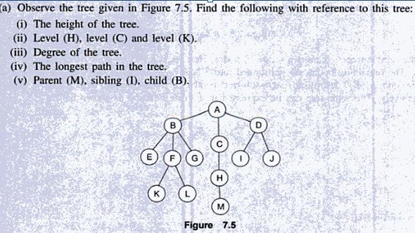

Slide 11
Tree Definition
A tree is a set of one or more nodes such that
1. There is a specially designated node
called the root.
2. The remaining nodes are partitioned in
to n(n>0) disjoint sets T₁,T₂,T₃…T_{n} where
each T_{i}(i=1,2,3..n) are trees. T₁,T₂,T₃…T_{n}
are said to be subtrees of the root

Slide 12
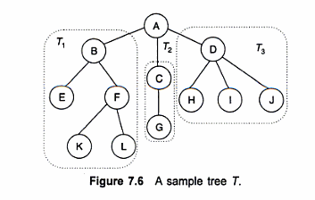

Slide 13
k-ary or m-ary Tree
A k-ary tree is a rooted tree in which each node has no more than k children. It is also sometimes known as a k-way tree, an n-ary tree, or an m-ary tree.
A full k-ary tree is a k-ary tree where within each level every node has either 0 or k children.
A binary tree is the special case where k=2.

Slide 14
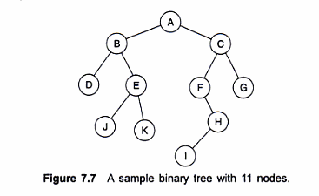
Binary Trees- Definition
A binary tree T is defined as finite set of nodes such that
1. T is empty(Empty Binary Tree) or
2. T contains a specially designated node called root node of T, remaining nodes to T form two disjoint binary trees T₁ and T₂ which are called left sub tree and right sub tree.

Slide 15
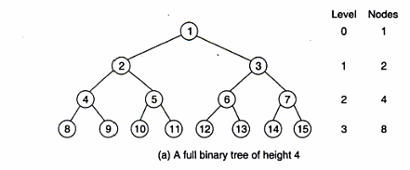
Full Binary Tree
A full binary tree is defined as a binary tree in which all nodes have either zero or two child nodes. i.e. every node other than the leaves has two children.

Slide 16
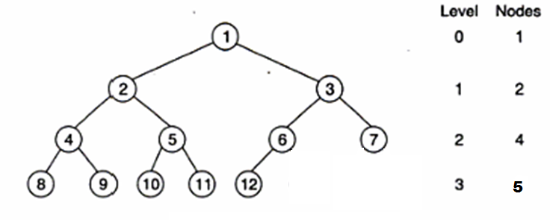
Complete BT
A Binary tree is complete if all its levels except possibly the last level have maximum number of possible nodes, and all nodes in the last level appear as left as possible.

Slide 17
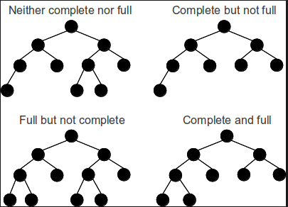

Slide 18
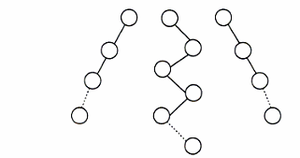
Skewed BT
Every node has only one child or minimum number of nodes at each level

Slide 19
Properties Of Binary Tree
Maximum no: of nodes on level l is 2^{l} ,where l>=0
Maximum no: of nodes possible in a binary tree of height h is 2^{h}-1
Minimum no: of nodes possible in a binary tree of height h is h(skew binary tree)
For any non empty binary tree, if n is the no: of nodes and e is the no: of edges then n=e+1

Slide 20
Representation of a binary tree
Linear(sequential) representation using array
Linked list representation using pointers

Slide 21
1. Linear representation using array
Tree Nodes are stored in a linear data structure like array.
Static as memory has to be allocated for an array.
Tree cannot be extended.
Nodes are stored level by level.
Starts from root(zeroth level)

Slide 22
Rules to find location of a node in a tree:
1.Root node is at location 1
2. for any node with index i (1<i<=n)
a. Parent(i)=Floor(i/2)
For a node when i=1, there is no parent
b.Leftchild(i) = 2 * i
If 2*i>n, there is no left child.
c. Right Child of (i)= 2*i+1
If 2*i+1>n, there is no right child.

Slide 23
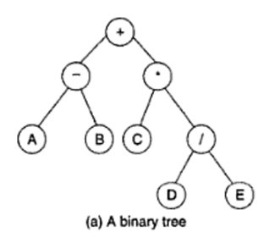
Eg: Consider array representation of expression
(A-B)+C*(D/E) in the form of a tree.

Slide 24
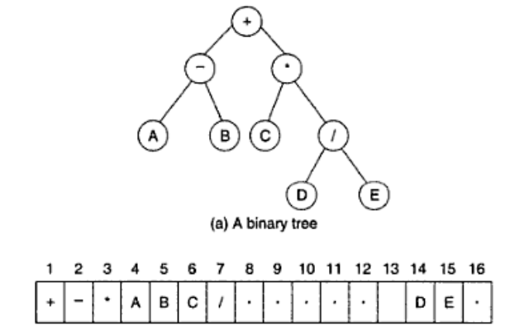

Slide 25
Advantages
Any node can be accessed from anywhere by calculating index.
No pointers, only data, hence saves memory.
Programming languages where dynamic memory allocation is not possible(such as BASIC, FORTRAN), array representation is the only way to store a tree.

Slide 26
Disadvantages
Other than full binary tree, most of the array entries are empty.
Tree cannot be extended as it allows only static representation.
Inserting / Deleting an element requires considerable amount of data movement in the array. Thereby processing time is increased.

Slide 27
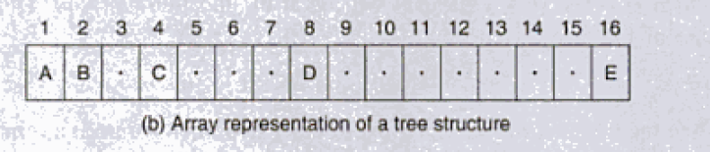
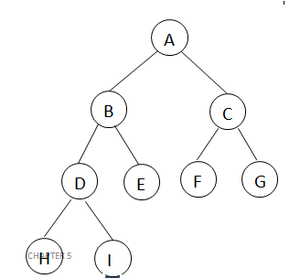
TUTORIAL 7
1. Draw the tree structure
2.Represent the following tree as array representation.

Slide 28
Implementation of BT using Array
Input: Index of array,i and item where item is the data content of at i.
Output: A binary tree.
Data Structure: Array Representation of tree.
BuikdTree(i,item)
A[i]=item
Read the option whether item at i has left child or not[Y/N].
If option = Y then
Read item to be inserted
Call BuildTree(2*i, item)
Read the option whether item at i has right child or not[Y/N].
If option = Y then
Read item to be inserted
Call BuildTree(2*i+1, item)

Slide 29
Binary Tree Operations using Array Representation
Insertion
Deletion
Searching

Slide 30
Insertion To BT using Array (or Insertion to sequential representation of BT)
Insert_seq(key,item)
1. search_seq(1,key)
2. i=ret_ser
3. if(i==0) then
3.1 Display Search Unsuccessful
4. else
4.1. if((a[2*i]==0)||(a[2*i+1]==0)) then
4.1.1. read option to insert as lChild or RChild?
4.1.2. if(opt==1) then
a. if(a[2*i]==0) then
1. a[2*i]=item
b. else
1. Display insertion not possible as left child
4.1.3. else
a. if(a[2*i+1]==0) then
1. a[2*i+1]=item
b. else
1. Display insertion not possible as right child
4.2 else
Display insertion not possible as leaf node.

Slide 31
Search Operation in array repr
Assume global variable int flag=0 and int ret_ser=0
ret_ser=index where element is located in array, size= max size of array, key is the data of node to be searched for.
Algorithm search_seq(i,key)
1. if(flag==0)
1.1 if(a[i]==key)
1.1.1 flag=1;
1.1.2 ret_ser=i;
1.2 else
1.2.1 if(2*i<=size) then
search_seq(2*i,key);
1.2.2 if(2*i+1<=size) then
search_seq(2*i+1,key);
1.3 End if
2.End if
3.Stop

Slide 32
Deletion in array/sequential representation of BT
delete_seq(item)
1. search_seq(1,item);
2. i=ret_ser;
3. if(i==0) then
3.1 Display no such data in tree
4. else
4.1 if(a[2*i]==0&&a[2*i+1]==0) then
a[i]=0;
4.2 else
Display deletion not possible as leaf node
4.3 end if
5. End if
6. Stop

Slide 33
2. Linked Representation of a tree
left_child
data
right_child
data
left_child
right_child

Slide 34
/* a node in the tree structure */
struct node {
struct node *lchild;
int data ;
struct node *rchild;
};
-- The pointer lchild stores the address of left child node.
-- The pointer rchild stores the address of right child node.
-- if child is not available NULL is stored.
-- a pointer variable root represents the root of the tree.

Slide 35
Creation of Linked BT
Build_Tree(ptr)
Input: ptr is the node passed. Initial case it is the root of tree.
Output: A binary tree with two sub trees of node PTR
Data structure: Linked List Structure of Binary tree
Read data in item
ptr->data=item
ptr->lc=NULL, ptr->rc=NULL
Node ptr has Left Sub tree (Option Y/N?)
If option=Y then
5.1 create newnode lcptr and allocate memory.
5.2 ptr->lc=lcptr
5.3 call Build_Tree(lcptr)
6. Node ptr has right Sub tree (Option Y/N?)
7. If option=Y then
7.1 Create newnode rcptr and allocate memory.
7.2 ptr->rc=rcptr
7.3 call Build_Tree(rcptr)

Slide 36
Operations on a BT
Traversal : To visit all nodes in a binary tree.
Insertion : To add a node into a binary tree.
Deletion : To delete a node from a non empty binary tree.
Merge : To merge two binary trees into a larger one.

Slide 37
Tree traversals
A binary tree is defined recursively: it consists of a root, a left subtree, and a right subtree.
To traverse (or walk) the binary tree is to visit each node in the binary tree exactly once.
Tree traversals are naturally recursive.
Since a binary tree has three “parts,” there are six possible ways to traverse the binary tree:
1.root, left, right 4.root,right,left
2.left, root, right 5.right,root,left
3.left, right, root 6.right,left,root

Slide 38
Left, Root, Right-> Inorder Traversal
Root, Left, Right-> Preorder Traversal
Left, Right, Root-> Postorder Traversal

Slide 39
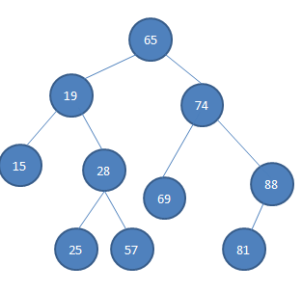
Preorder: 65 19 15 28 25 57 74 69 88 81
Inorder: 15 19 25 28 57 65 69 74 81 88
Postorder: 15 25 57 28 19 69 81 88 74 65

Slide 40
Preorder traversal
Visit root node R
Traverse the left sub tree of root node R in preorder.
Traverse the right sub tree of root node R in preorder.
Algorithm preorder(ptr)
i/p: A node in the tree. Initially it is the root.
o/p: visiting all nodes in preorder fashion
Data structure: linked structure of binary tree.
1. if (ptr !=NULL) then
1.1. print(ptr->data); 1.2. preorder(ptr->lc); 1.3. preorder(ptr->rc);
2. Endif

Slide 41
Inorder traversal
Traverse the left sub tree of root node R in inorder.
Visit root node R
Traverse the right sub tree of root node R in inorder.
Algorithm inorder(ptr)
i/p: A node in the tree. Initially it is the root.
o/p: visiting all nodes in inorder fashion
Data structure: linked structure of binary tree.
1. If (ptr !=NULL) then 1.1 inorder(ptr->lc);
1.2. print(ptr->data); 1.3. inorder(ptr->rc);
2. Endif

Slide 42
Postorder traversal
Traverse the left sub tree of root node R in postorder.
Traverse the right sub tree of root node R in postorder.
Visit root node R
Algorithm postorder(ptr)
i/p: A node in the tree. Initially it is the root.
o/p: visiting all nodes in postorder fashion
Data structure: linked structure of binary tree.
1. If (ptr !=NULL) then 1.1. postorder(ptr->lc);
1.2. postorder(ptr->rc);
1.3. print(ptr->data);
2. Endif

Slide 43
Other traversals
The other traversals are the reverse of these three standard ones
That is, the right subtree is traversed before the left subtree is traversed.
Reverse preorder: root, right subtree, left subtree
Reverse inorder: right subtree, root, left subtree
Reverse postorder: right subtree, left subtree, root

Slide 44
Inserting an Element into a Binary Tree(Leaf node)
Insert(Key, ITEM)
Key be the data after which a new node has to be inserted
ITEM is the new data
search_node(root,Key)
ptr=ptr2
3. If ptr==NULL then
print Searched item not found.
4. If ptr->lc=NULL or ptr->rc=NULL then
4.1. read option to insert as left or right?
4.2. if Option=L then
4.2.1. if ptr->lc=NULL then
a. create a new Node new.
b. ptr->lc=new
c. new->data=ITEM
d. new->lc=new->rc=NULL
4.2.2. else
print Insertion not possible as left Child
4.3. else
4.3.1. if ptr->rc=NULL then
a. create a new Node new.
b. ptr->rc=new
c. new->data=ITEM
d. new->lc=new->rc=NULL
4.3.2. else
print Insertion not possible as right Child.
5. Else
print node has no empty children hence insertion not possible.

Slide 45
Search Operation
Assume global variable int flag=0 and ptr2 is the global pointer variable of structure tree
ptr=root and key is the data of node to be searched for.
Algorithm search_node(ptr,key)
1. if((ptr!=NULL)&&(flag==0))
1.1. if(ptr->data==key)
1.flag=1;
2.ptr2=ptr;
1.2. else
1.search_node(ptr->lc,key);
2.search_node(ptr->rc,key);
1.3. End if
3.End if
4. stop

Slide 46
Delete a node(leaf)
Algorithm delete_leaf(ptr,item)
If(ptr==NULL)
1. print “tree is empty”
2. exit
2. End if
3. search_parent(root,item,NULL)
4. parent=ptr3
5. if(parent!=NULL)
5.1. ptr1=parent->lc
5.2. ptr2=parent->rc
5.3. if(ptr1->data==item)
5.3.1. if(ptr1->lc==NULL) and (ptr1->rc==NULL)
parent->lc=NULL
5.3.2. else
print “Node is not a leaf node”
5.4. else
5.4.1 if(ptr2->lc==NULL) and (ptr2->rc==NULL)
parent->rc=NULL
5.4.2 else
print node is not a leaf node
6. Else
6.1. print no such node exist

Slide 47
Search parent
Assume global variable int f1=0 and ptr3 is the global pointer variable of structure tree
ptr=root and key is the data of node to be searched for.
Algorithm search_parent(ptr,key, parent)
1. if((ptr!=NULL)&&(f1==0))
1.1. if(ptr->data==key)
a) f1=1;
b) ptr3=parent;
1.2. else
a) search_parent(ptr->lc,key,ptr);
b) search_parent(ptr->rc,key,ptr);

Slide 48
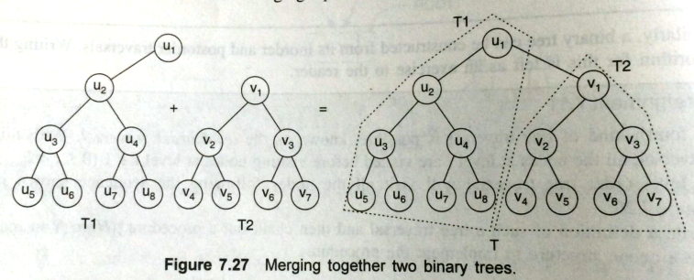
Merge Operation
Possible only for linked list representation.
If T₁ and T₂ are two binary trees, T₂ can be merged into T₁ only if T₁ root has atleast one subtree empty.

Slide 49
Algorithm Mergetrees(*root,*root1)
Here root3 is the root node of resultant tree after merging
1. if(root==NULL) then
1.1. root3=root1;
2. else if(root1==NULL) then
2.1. root3=root;
3. else if(root->lc==NULL||root->rc==NULL) then
3.1. if(root->lc==NULL) then
a) root->lc=root1;
b) root3=root;
3.2. else
a) root->rc=root1;
b) root3=root;
4. else if(root1->lc==NULL||root1->rc==NULL) then
4.1. if(root1->lc==NULL) then
a) root1->lc=root;
b) root3=root1;
4.2. else
a) root1->rc=root;
b) root3=root1;
5. else
Display Merging not possible

Slide 50
Height of BT
int max(int a,int b)
{
if(a>=b)
return a;
else
return b;
}
int height(struct tree *ptr)
{
if(ptr==NULL)
return 0;
else
return 1+max(height(ptr->lc),height(ptr->rc));
}
Fn call: height(root)

Slide 51
Application of BT
Expression Tree
BT which stores arithmetic expression.
Leaves of expression tree are operands, such as constants or variable names, and all internal nodes are operators
Binary Search Tree
Heap Tree
Height balanced tree
Decision Tree
Huffman tree

Slide 52
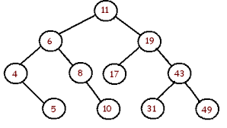
BINARY SEARCH TREE
A binary tree T is termed as binary search tree if each node N of T satisfies the following property:
The value of N is greater than every value in the left sub-tree of N and is less than every value in the right sub-tree of N.

Slide 53
Operations on a BST
Traversal : To visit all nodes in a binary search tree.
Search : To search a binary search tree for a particular data.
Insertion : To include a node into an binary search tree.
Deletion : To delete a node from a non empty binary search tree.
- The time complexity of searching, insertion and deletion = O(h) where h is the height of the tree.

Slide 54
Traversals on BST
Note : All traversal operations discussed in Binary Tree can be used here without any alterations.
Inorder traversal in BST will give a sorted list of data in ascending order.
So in order to sort data, a BST can be constructed with the data available and inorder traversal can be applied. This method of sorting is called Binary Sort and hence binary search tree is also called as Binary Sorted Tree.

Slide 55
Searching a BST
i/p: item is the data to be searched, root of BST
o/p: if found then pointer to the node containing data item else a message.
DS: linked structure of BT.
Algorithm: search_bst(item,root)
ptr=root, flag=0
While((ptr!=NULL) && (flag=0)) do
if item<ptr->data then
ptr=ptr->lchild
else if ptr->data=item then
flag=1
else
ptr=ptr->rchild
Endwhile
if (flag=1)
print item found
else
print item does not exist
end if

Slide 56
Inserting a node into a BST
i/p: item is the data to be inserted, root of BST o/p: if no node having data item, it is inserted into the tree, else a message.
DS: linked structure of BT.
Algorithm: insert_bst(item,root)
ptr=root, flag=0
While((ptr!=NULL) && (flag=0)) do
2.1 If item<ptr->data
ptr1=ptr
ptr=ptr->lchild
2.2 else if ptr->data=item
flag=1
print item already exists and exit()
2.3 Else
ptr1=ptr
ptr=ptr->rchild
Endwhile
if (ptr==NULL) then
1. Create new node say new
2. new->data=item
3. new->lchild=NULL
4. new->rchild=NULL
5. if(item>ptr1->data)
1. ptr1->rchild=new
6. else
1. ptr1->lchild=new
End If
Stop

Slide 57
Deleting a node from a BST
Three cases exist
Case 1: N is the leaf node.
Case 2: N has exactly one child.
Case 3: N has two childs.

Slide 58
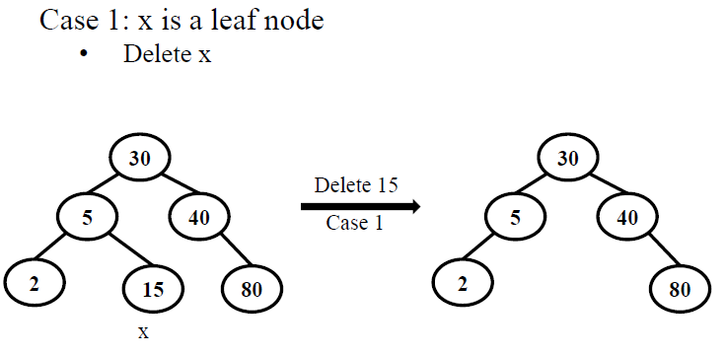

Slide 59
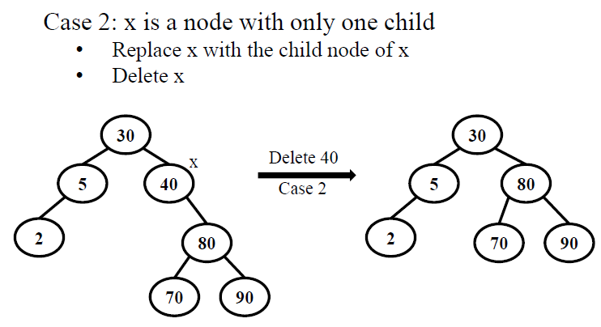

Slide 60
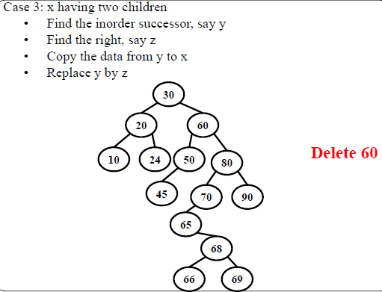

Slide 61
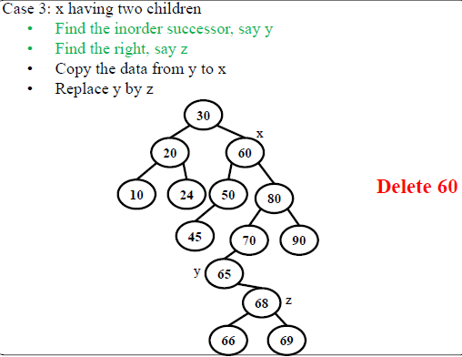

Slide 62
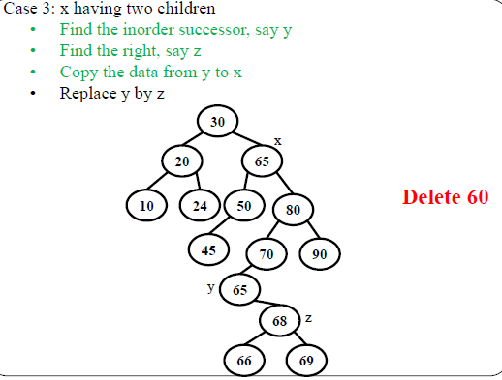

Slide 63
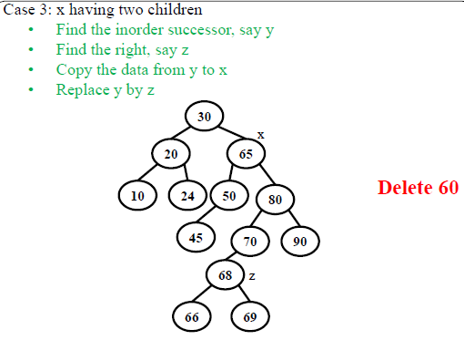

Slide 64
Algorithm delete_BST(root,item)
i/p: item is the data to be deleted, root of BST
o/p: if node with item exists it is deleted else a message
DS: linked structure of BT
ptr= Root, flag=0
2. While(ptr!=NULL) &&(flag==0)
2.1. If item<ptr->data
1. parent=ptr
2. ptr=ptr->lchild
2.2. Else if item>ptr->data
1. parent=ptr
2. ptr=ptr->rchild
2.3. Else
1. flag=1
3. If(flag==0)
1. Print “Item does not exist”
2. Exit

Slide 65
4. If((ptr->lchild==NULL) &&(ptr->rchild==NULL))
case=1
5. else if(ptr->lchild==NULL) ||(ptr->rchild==NULL)
case=2
6. else
case=3
7. if(case==1)
7.1. if(parent->lchild=ptr)
parent->lchild=NULL
7.2. Else
parent->rchild=NULL

Slide 66
8. Else If(case==2)
8.1. If(parent->lchild=ptr)
1. If(ptr->lchild==NULL)
1. parent->lchild=ptr->rchild
2. Else
1. parent->lchild=ptr->lchild
8.2. Else If(parent->rchild=ptr)
1. If(ptr->lchild=NULL)
1. parent->rchild=ptr->rchild
2. Else
2. parent->rchild=ptr->lchild
9. Else
9.1. ptr1=inorder_succ(ptr)
9.2. item1=ptr1->data
9.3. delete_BST(root,item1)
9.4. ptr->data=item1

Slide 67
struct tree *inorder_succ(struct tree *ptr2)
1. ptr2=ptr2->rc;
2. while(ptr2->lc!=NULL)
2.1 ptr2=ptr2->lc;
3. return(ptr2);

Slide 68
Applications of BST
Searching for an element.
Sorting a set of data.
Remove Duplicates
Used to define other Data structures such as B tree

